Slide 1
Why MENA Fixed Income?
Altered Destinies In a Well Oil-ed Global Environment
Azimut (DIFC) is incorporated in the DIFC and regulated by the Dubai Financial Security Authority (DFSA)
AZIMUT (DIFC) LTD
November 2023
PRIVATE AND CONFIDENTIAL

Slide 2
"We learn from history that we do not learn from history." - Georg Wilhelm Friedrich Hegel
1.

Slide 3
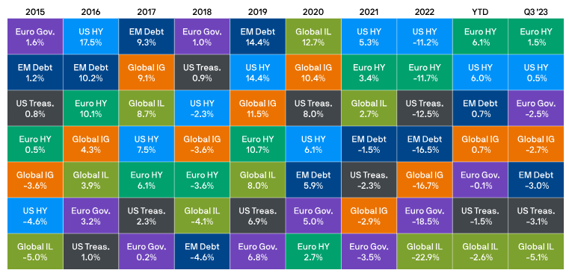
World Fixed Income Returns
YTD 2023
Source: Bloomberg Barclays, BofA/Merrill Lynch, J.P. Morgan Economic Research, LSEG DataStream, J.P. Morgan Asset Management. Global IL: Bloomberg Global Inflation-Linked; Euro Gov.: Bloomberg Euro Aggregate - Government; US Treas: Bloomberg US Aggregate Government - Treasury; Global IG: Bloomberg Global Aggregate - Corporate; US HY: BofA/Merrill Lynch US HY Constrained; Euro HY: BofA/Merrill Lynch Euro Non-Financial HY Constrained; EM Debt: J.P. Morgan EMBIG. All indices are total return in local currency, except for EM and global indices, which are in US dollars. Data as of 30 September 2023.

Slide 4
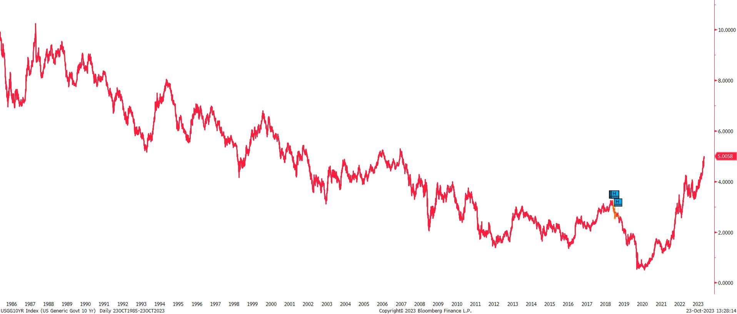
What happened in 2023?
Bond Markets continue to play catch up….
US 10 Year Treasury Yields, 1985-2023
Bond yields have surged to 16-year highs. We think the market is adjusting to the new “higher for longer” narrative and its implications – especially higher macro volatility.
Source: Bloomberg, As of 23rd October 2023

Slide 5
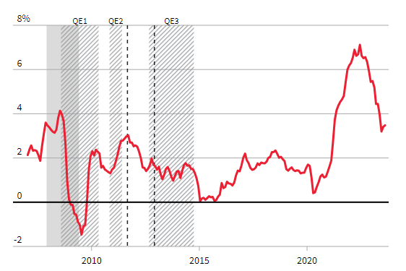
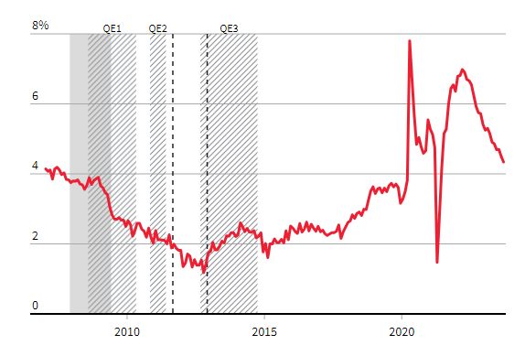
What happened in 2023?
Inflation is falling as pandemic-induced mismatches resolve…
U.S. CORE PCE INFLATION
U.S. AVERAGE HOURLY WAGES Y-O-Y
Supply shocks causing inflation creating bottlenecks have eased
Goods prices are dragging inflation down as demand normalizes
Skills mismatch is also normalizing, helping cool wage growth
Source: Bloomberg, Thomson Reuters, As of October 2023

Slide 6
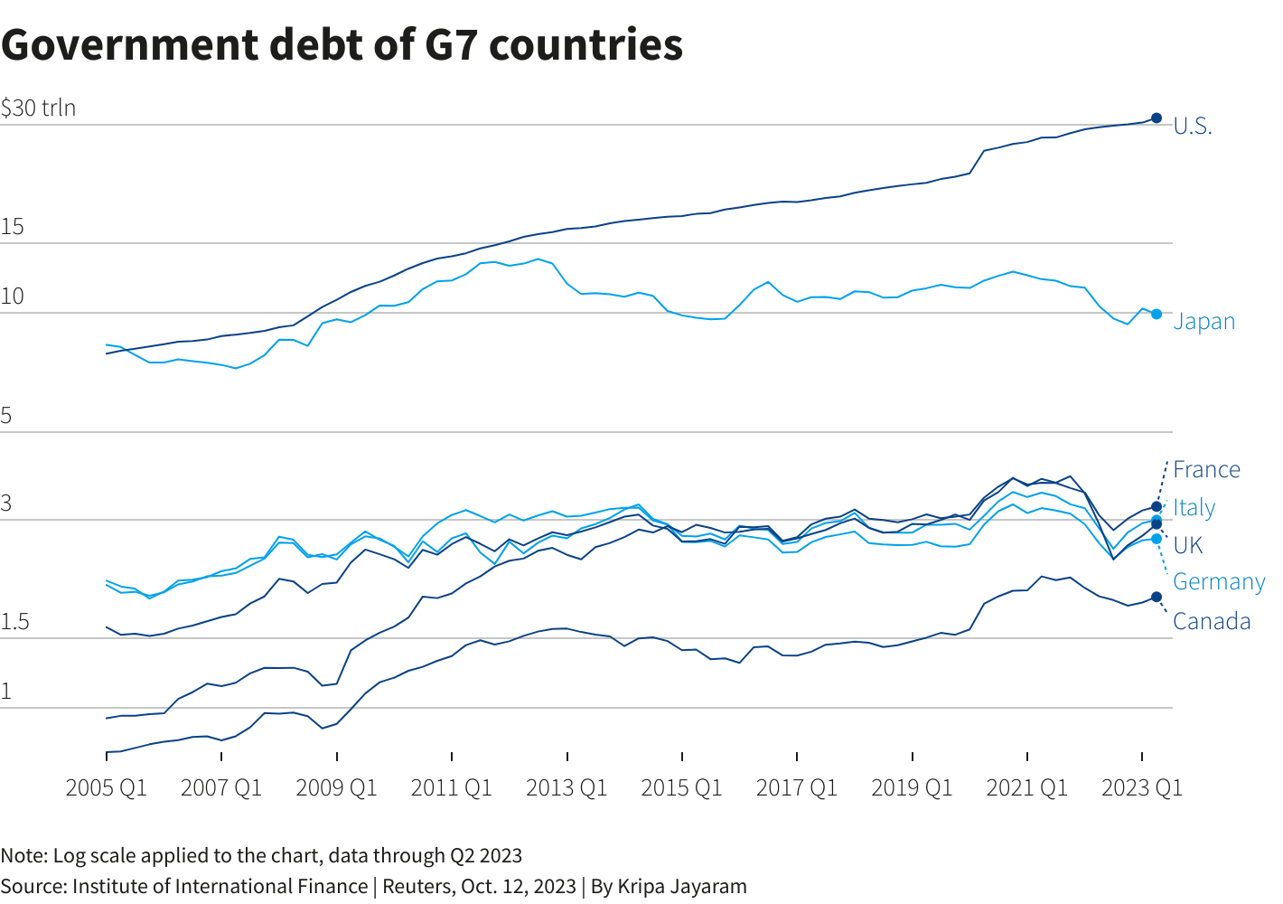
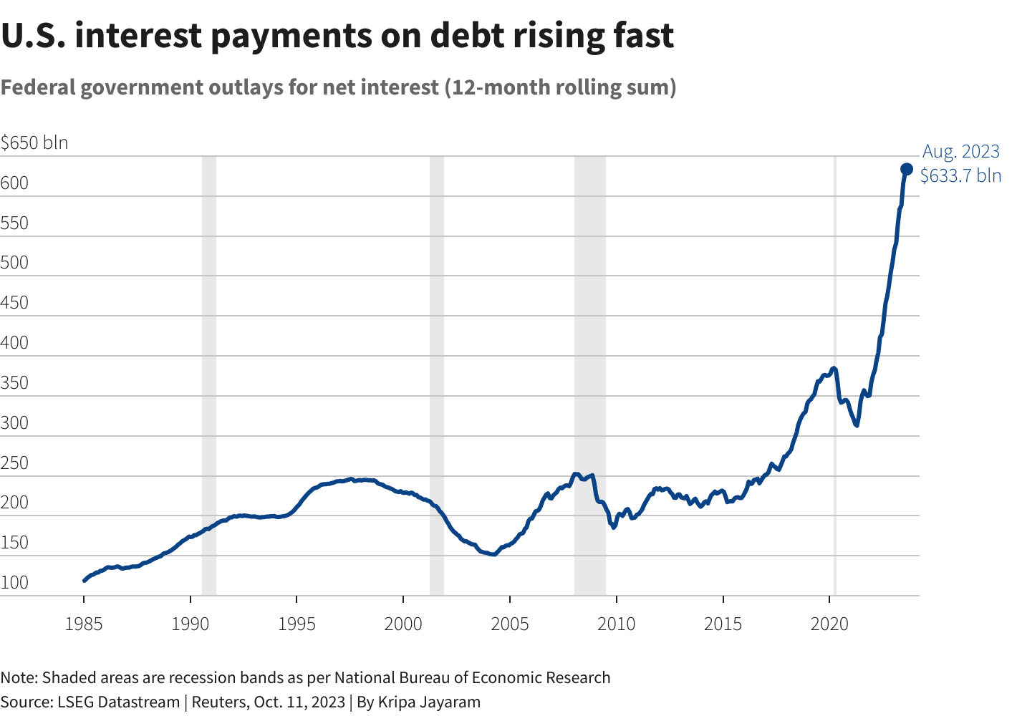
What happened in 2023?
We have a DEBT problem!
A surge in government borrowing costs has put high debt in the spotlight, with investors demanding increased compensation to hold long-term bonds and policymakers urging caution on public finances.
Source: Bloomberg, IIF, Thomson Reuters, As of October 2023

Slide 7
State of Hysteresis: The lag between the action and the reaction
1.

Slide 8
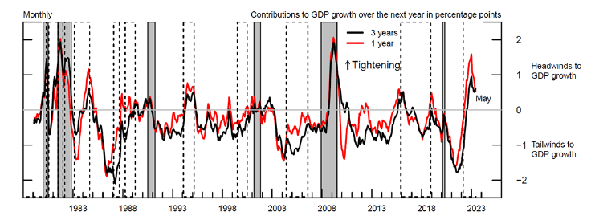
Financial Conditions Impulse on Growth over a Long Period
Note: The figure shows the Financial Conditions Impulse on Growth computed with a 1-year and 3-year lookback window, respectively, in red and black. Positive (negative) values of the two indexes denote headwinds (tailwinds) to GDP growth over the next year. The upward arrow indicates the direction of tightening of financial conditions and increasing headwinds to future GDP growth. Gray shaded bars denote periods of recession as dated by the National Bureau of Economic Research: January 1980-July 1980, July 1981-November 1982, July 1990-March 1991, March 2001-November 2001, December 2007- June 2009, and February 2020-April 2020. The dashed bars represent monetary policy tightening cycles: February 1977-May 1980, August 1980-July 1981, January 1982-March 1982, March 1983-September 1984, February 1987-September 1987, April 1988-April 1989, February 1994-March 1995, July 1999-July 2000, June 2004-August 2006, December 2015-July 2018, March 2022-present. Tightening cycles are defined to start on the month of the first federal funds rate increase and end after the last rate hike.
Source: Haver Analytics; U.S. Census Bureau, Decennial Census of Population and Housing; CoreLogic; Authors' calculations.

Slide 9

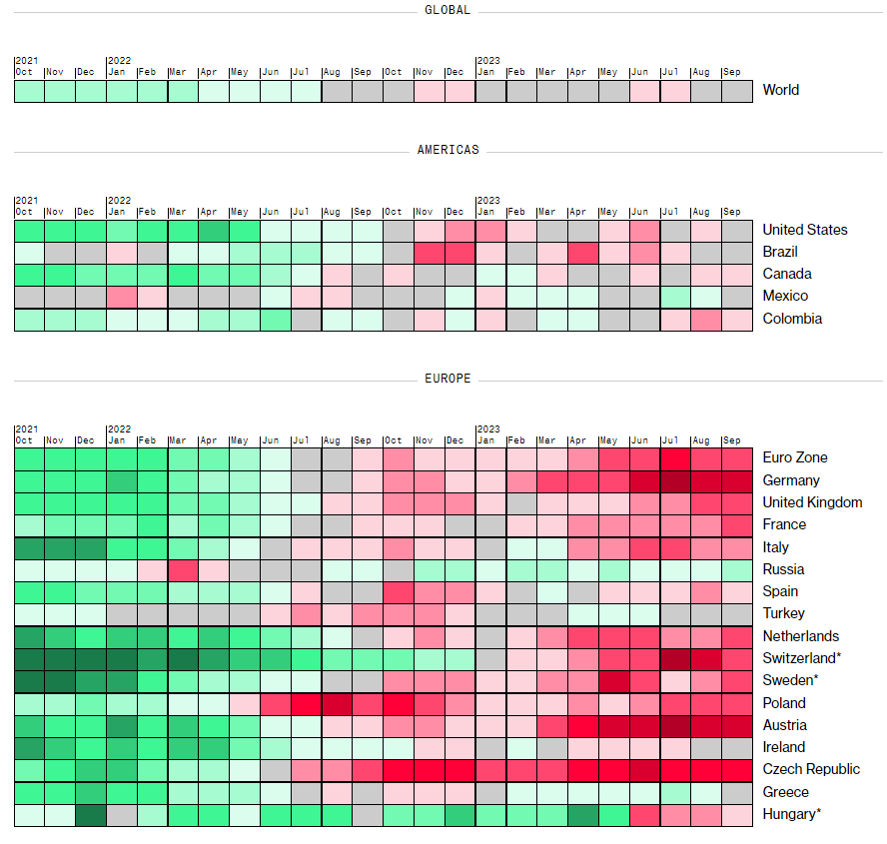
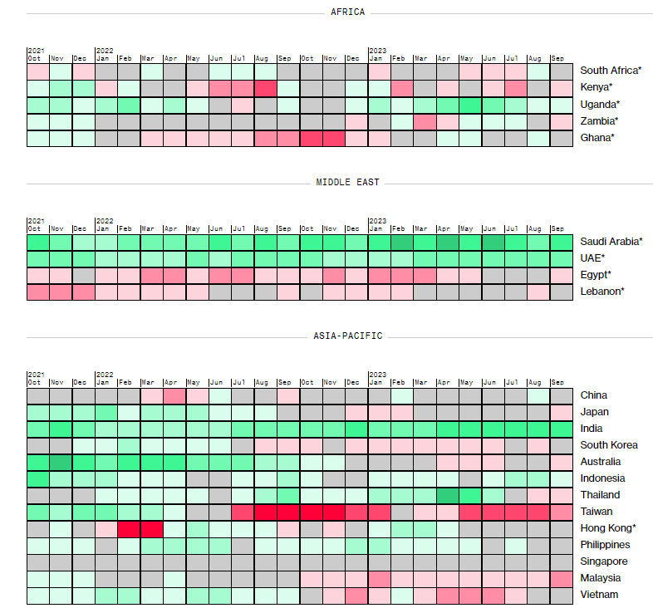
Global Manufacturing Purchasing Manager’s Index
Source: Bloomberg, As of October 2023

Slide 10
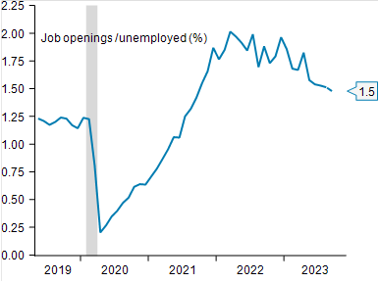
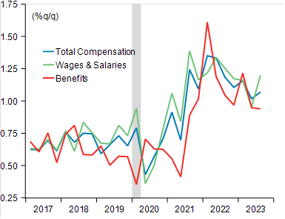
Powell's key labor market measure to continue signaling a tight but rebalancing jobs market
Job openings- to-unemployed Ratio
Employment Cost Index components
One of Chair Powell's preferred gauges, the openings-to-unemployed ratio, has fallen to 1.5 from the peak of 2.0 reached in March of last year. Expectations for a slight decline in job openings would keep the ratio at its current level.
Q3 Employment Cost Index showed wage pressures advanced 1.1% q/q. As state and local government wages rose 1.8% q/q versus private sector wages rising just 1.1% q/q.
Source: BLS, Macrobond, BNP Paribas
Notes:
tQ3 Employment Cost Index showed wage pressures advanced 1.1% q/q, an increase from Q2's (and consensus' estimate of) 1.0%. While the annual rate of ECI growth remains above the ~3% level historically consistent with 2% inflation, the year-on-year change fell to 4.3% (prior: 4.5%), suggesting the direction of travel remains to the downside.
While the wages and salaries component of the ECI printed a bit hotter than the overall index at 1.2% q/q, the details showed a bit more of a benign story, as state and local government wages rose 1.8% q/q versus private sector wages rising just 1.1% q/q (steady at 4.6% y/y). Price pressures are easing, but a mismatch between labor supply and demand (particularly in education and healthcare) has kept employee wages at elevated levels.

Slide 11
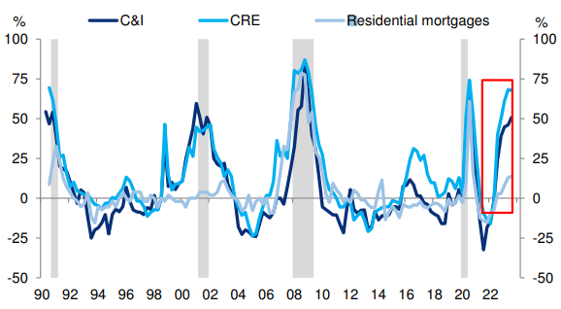
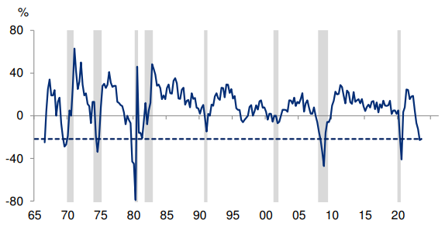
US Recession around the corner?
SLOOS: Net percent of banks tightening lending
standards at recession levels
Banks’ willingness to lend to consumers also at
recession levels
Source: FRB, Haver Analytics, Deutsche Bank, October 2023 , Treasury, Macrobond, BNP Paribas
Notes:
C&I – COMMERCIAL AND INDSUTRIAL LENDING, CRE- COMMERCIAL REAL ESTATE

Slide 12
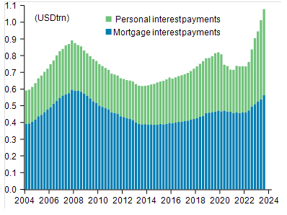
We think, Yes. : Why? Consumer Resilience fading…
Interest payments rising rapidly
Personal Saving as % of Disposable personal income
Q323 consumer resilience faces a critical test in Q4.
4.9% q/q saar gain in Q3 GDP was heavily skewed towards the consumer, making the future growth trajectory overly dependent on disposable personal income growth prospects
Expected consumer downshift in Q4 and into 2024 considering a rapid rise in consumer debt servicing costs amid gradually slowing wage growth
Source: Bloomberg, Treasury, Macrobond, BNP Paribas, New York Fed Consumer Credit Panel/Equifax,
Notes:
Personal interest payments (including student loans and mortgage payments) have increased by about $300 billion from the start of 2022 and with credit card and mortgage rates hitting new highs

Slide 13
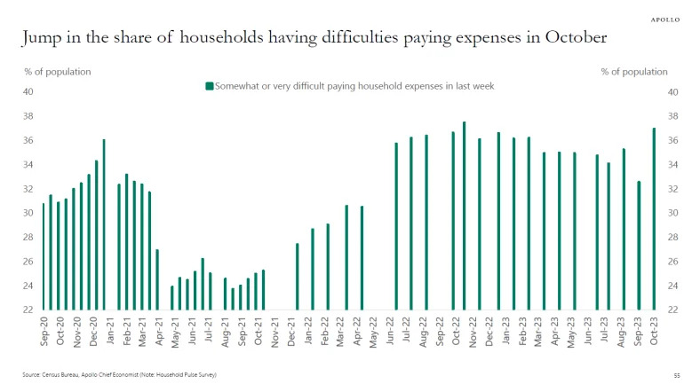
We think, Yes. : Why? Consumer Resilience fading…
Repayment of the more than USD 1.7 trillion in federal student loan debt, started in October

Slide 14
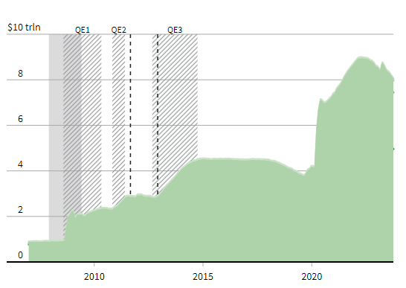
Technical Headwinds also at Play:
Liquidity is drying up.. The Biggest buyer is refusing to buy!
What’s in a Balance Sheet?
Total Public Debt (2000-2023)
The U.S. government posted a USD 1.695 trillion budget deficit in fiscal 2023, a 23% jump from the prior year as revenues fell and outlays for Social Security, Medicare and record-high interest costs on the federal debt rose.
The deficit was the largest since a COVID-fueled USD 2.78 trillion gap in 2021. It marks a major return to ballooning deficits after back-to-back declines during President Joe Biden's first two years in office.
Source: Bloomberg, Thomson Reutuers,, U.S. Department of the Treasury. Fiscal Service

Slide 15
Moving On,
Why should YOU Invest in the Middle East region?
4Cs of MENA Fixed Income : Credit Rating, Currency, Current Account and Commodity
1.

Slide 16
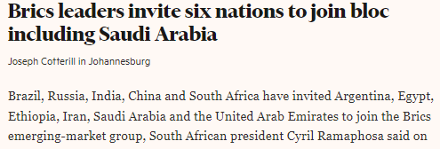
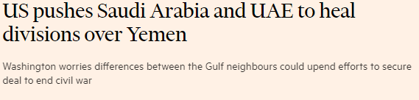
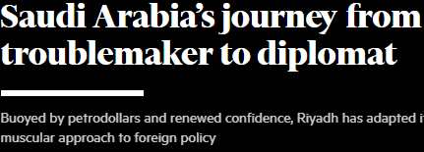
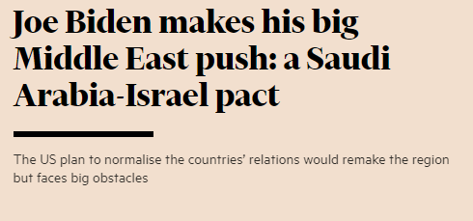
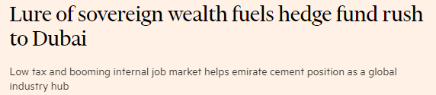
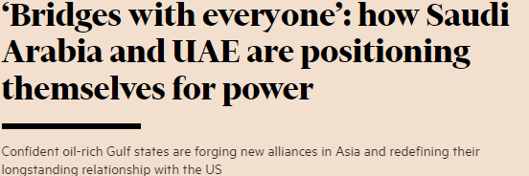
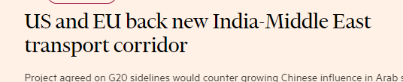

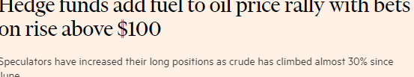
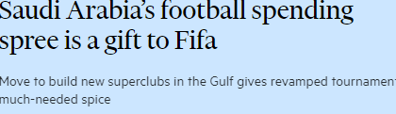
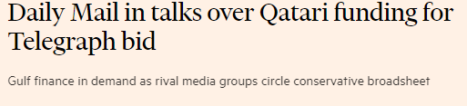
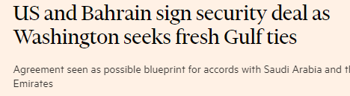
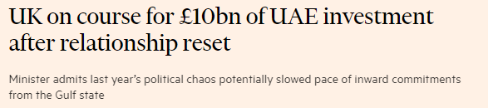
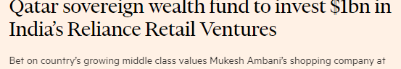
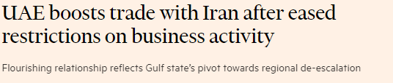
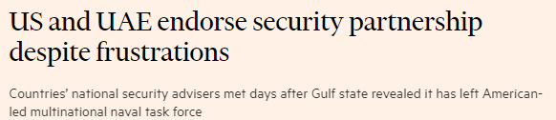
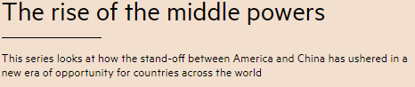
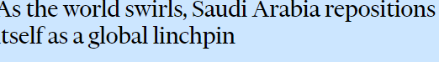
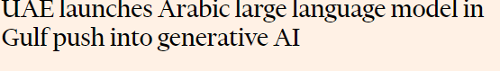
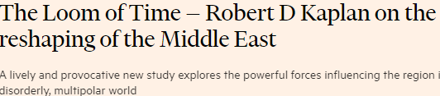

Slide 17
Slowly Steadying the Ship
Why Middle East exposure is crucial for Global Investors?
Growth Outlook Remains Firm
Low Inflation compared to similar rated peers
Strong External Position and Debt Metrics
Structural Reforms Momentum Attracting Strong Flows
Favorable Demographics with Strong Job Creation
Non-Oil GDP Growth Gaining Pace
Optimum Blend of Yield, Carry, and Credit Quality added with lower FX Risk

Slide 18
Coffers remain full…
Foreign Exchange Reserves (USD Bn)
Source: IMF, Azimut

Slide 19
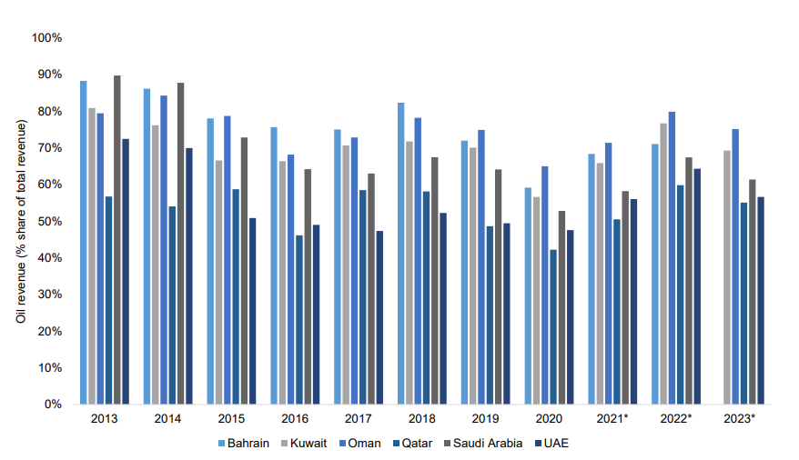
Oil Revenue % Share of Total Revenues
Work in Progress…
Source: IIF estimates, ADCB
Source: Bloomberg, Azimut Date 26th September 2023

Slide 20
Break-even Oil Prices Remain Low
Source: National authorities; and IMF staff estimates and projections.

Slide 21
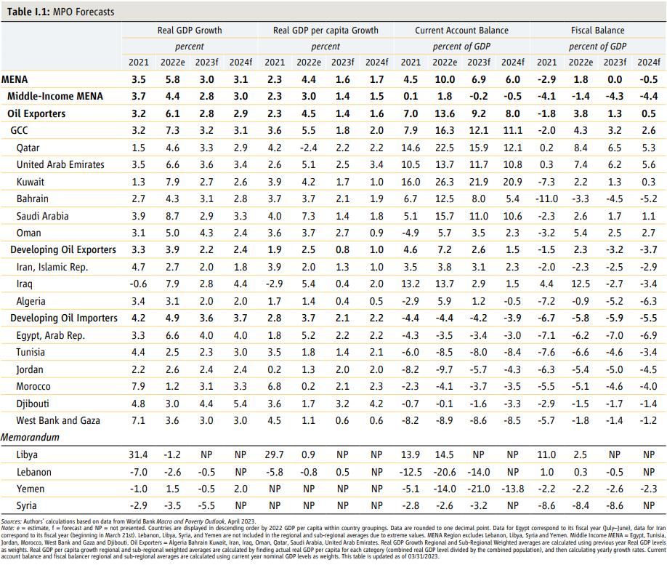
Economic Statistics

Slide 22
Let’s delve deeper,
1.

Slide 23
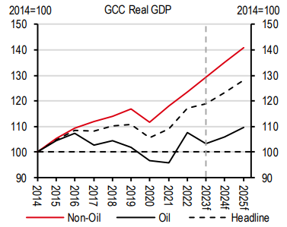
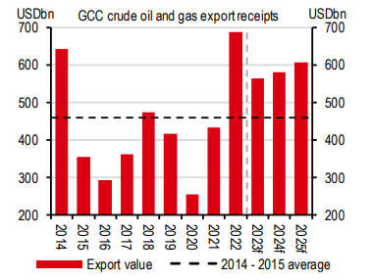
Regional Update
OPEC cuts weigh on headline growth but not the broader economy, wherein the robust revenues and not volumes matter
The non-oil sector is expected to be the dominant driver of growth to account for over 70% of GDP in the near future
Source: HSBC, Azimut

Slide 24
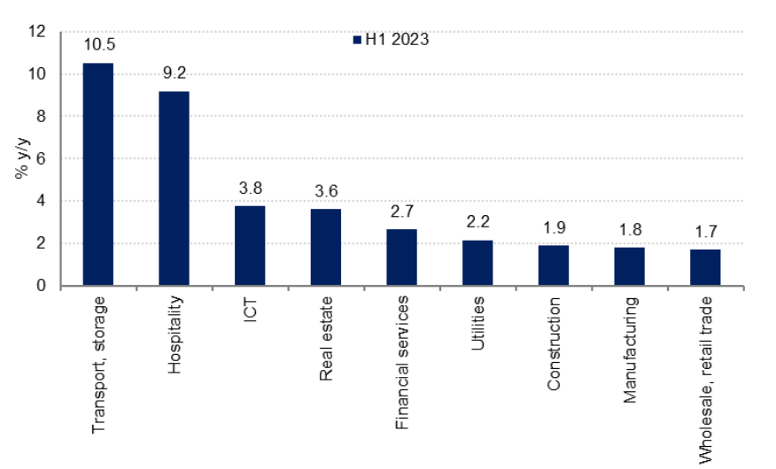
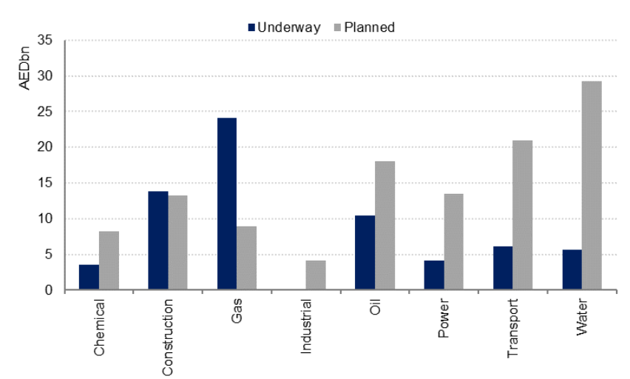
United Arab Emirates
Dubai: Key sector growth in H1 2023
UAE infrastructure projects through 2030
International visitor numbers soaring high, outlook for coming season remains positive
COP28 event to be held in Dubai, strong bookings for the first couple of months in 2024.
Sustained government investment in strategic growth sectors USD 18.5bn in infrastructure projects underway and due to be completed by 2028, with another USD 32bn in planned (but unawarded) investment through 2030.
Source: ENBD, Azimut
Notes:
International visitor numbers to Dubai reached 9.8mn in the year to July, up 2.6% from the same period in 2019. Hotel indicators also show a full recovery from the pandemic, with hotel occupancy and revenue per available room well above pre-Covid levels.
The outlook for the coming high season is also positive, with many hotels reporting full occupancy through Q4 2023, on the back of the COP28 event to be held in Dubai, and strong bookings for the first couple of months in 2024.
Sustained government investment in strategic growth sectors to offset some of the expected softness in private sector investment next year and beyond. Data shows almost AED 68bn in infrastructure projects underway and due to be completed by 2028, with another AED 116.3bn in planned (but unawarded) investment through 2030.

Slide 25
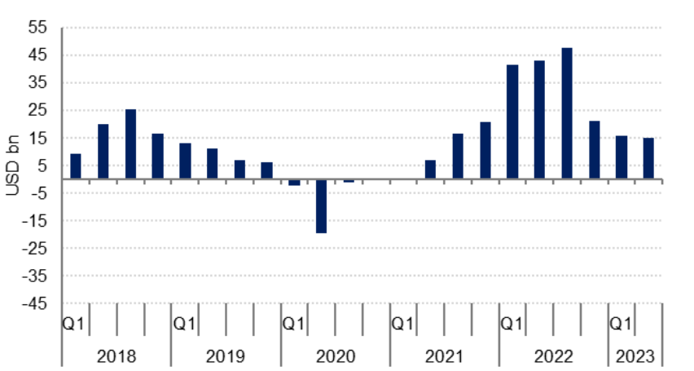
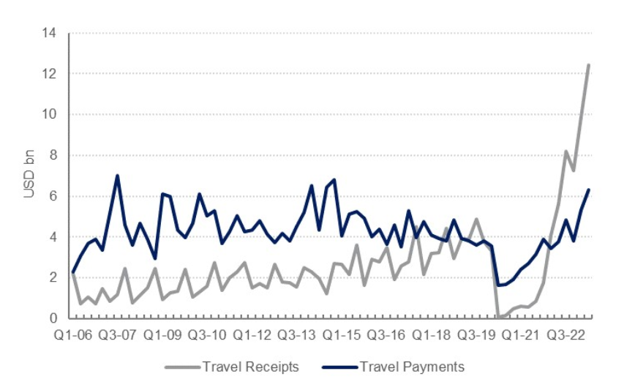
Kingdom of Saudi Arabia
Saudi Arabia current account balance
Travel services component of the current account
Current account recorded a balance of USD 15.2bn in Q2 and USD 31.3bn in H1 2023, the trade balance remained in surplus at USD 32.3bn
Services balance remained in deficit – the kingdom was a net importer of transportation, construction and other services – the travel services balance showed a marked improvement. Travel receipts reached a record high of USD 12.4bn in Q2 2023
Source: ENBD, Azimut
Notes:
Current account recorded a balance of USD 15.2bn in Q2 and USD 31.3bn in H1 2023, down more than 60% from the USD 84.6bn surplus recorded in H1 2022. Nevertheless, the trade balance remained in surplus at USD 32.3bn.
While the services balance remained in deficit – the kingdom was a net importer of transportation, construction and other services – the travel services balance showed a marked improvement. Travel receipts reached a record high of USD 12.4bn in Q2 2023, underpinned by a surge in visitors to the kingdom as new visas made it easier for both business travelers and tourists to go to Saudi Arabia
Even as outbound travel from the kingdom normalized post-pandemic, the overall balance on the travel services account reached USD 10.6bn in H1 2023, up from USD 2.4bn in H1 2022.

Slide 26
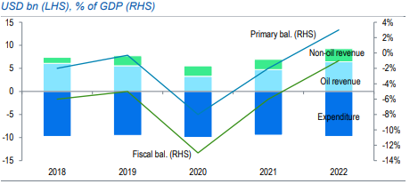
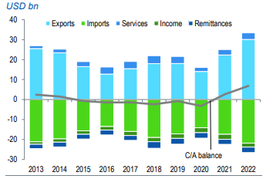
Kingdom of Bahrain
Fiscal Performance has improved
Record C/A surplus supports external buffers
Fiscal reform momentum has recovered, primary surplus of 3% of GDP in 2022, its first since 2011. The overall deficit fell to 1% of GDP (from a deficit of 6% in 2021 and 13% in 2020).
2023 budget forecasts an 11% y/y increase in non-oil revenue, supported by higher fees-related revenue and higher dividends from SOEs. Budgetary spending has remained contained.
Debt ratios improved in 2021-22, owing to strong nominal GDP growth and more contained deficits.
Source: Standard Chartered, Azimut
Notes:
Fiscal reform momentum has recovered, primary surplus of 3% of GDP in 2022, its first since 2011. The overall deficit fell to 1% of GDP (from a deficit of 6% in 2021 and 13% in 2020).
2023 budget forecasts an 11% y/y increase in non-oil revenue, supported by higher fees-related revenue and higher dividends from SOEs. Budgetary spending has remained contained, falling to 22% of GDP in 2022 from 26% in 2018, and is forecast to remain relatively flat in nominal terms in 2023-24 per the state budget.
High levels of indebtedness, significantly ahead of the single-B median, is a key constraint for Bahrain’s credit profile. That said, debt ratios improved in 2021-22, owing to strong nominal GDP growth and more contained deficits.

Slide 27
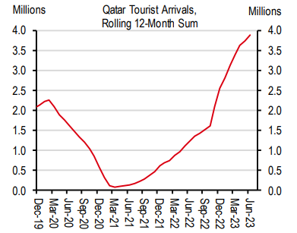
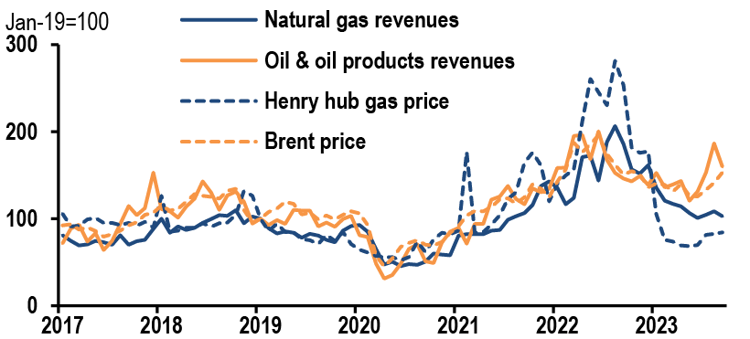
State of Qatar
Tourist Arrivals remain Strong
Qatar Hydrocarbon Exports
One of the lowest fiscal and external breakeven oil prices among the oil-exporting economies
Continued large fiscal and C/A surpluses support the government’s deleveraging strategy and should help boost QCB and Qatar Investment Authority assets (estimated at c.USD 460bn)
Visitor arrival numbers in Qatar remain well above their pre-World Cup levels
64% capacity increase expected at the North Field, which would take natural gas output to 126mn tonnes (Mt) by 2026 from 77Mt
Source: IMF, Azimut, HSBC, Standard Chartered, JPM, haver Analytics
Notes:
We do not expect Qatar to implement VAT, as GCC peers have done, until at least 2024.

Slide 28
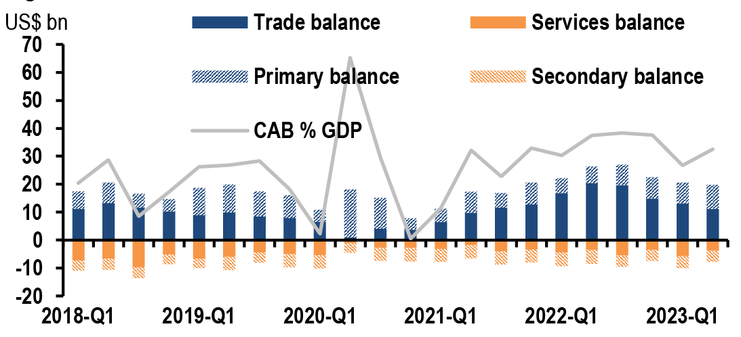
State of Kuwait
2Q323, current account balance reached USD12.2bn, about 33% of GDP. The surplus was wider than what was reported in 1Q23 (US$10.6bn) despite oil exports moving lower.
Politics continue to be the key risk for the outlook
A new debt law is not in sight, however high oil prices provide stability
The country is expected to run a sizable twin surplus
Source: IMF, JPM,

Slide 29
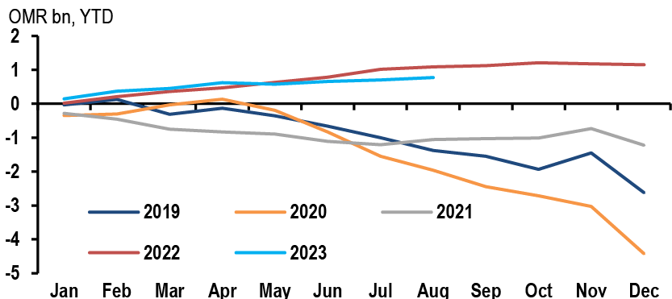
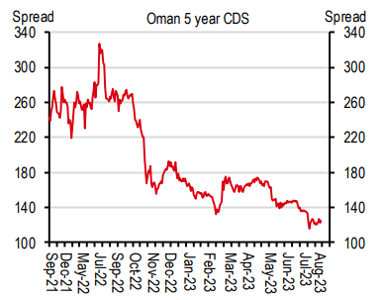
Sultanate of Oman
Oman Central Government Fiscal Balance
Government budget continues to report monthly surplus (USD 2bn in the first 8 months of 2023), surplus was achieved despite revenues moving lower due to oil and gas revenues
Recent upgrades to BB+ from Fitch and S&P were the latest in a string of upgrades that have pushed Oman back to the brink of investment grade.
Cautious policies and the sharp hydro prices recovery led to cut public and external debt, market confidence continues to improve
GDP expansion is slow as country tries to strike a balance between growth and fiscal cautiousness.
Source: JPM, HSBC, Azimut
Notes:
Oman central government budget continues to report monthly surplus. August reported a positive balance for OMR70mn (US$182mn) and a cumulative one for US$2bn in the first 8 months of 2023. The monthly surplus was achieved despite revenues moving lower due to oil and gas revenues which corrected in line with lower international prices.
Recent upgrades to BB+ from Fitch and S&P were the latest in a string of upgrades that have pushed Oman back to the brink of investment grade.
Cautious policies and the sharp hydro prices recovery led Oman to cut public and external debt, market confidence continues to improve
GDP expansion is slow as country tries to strike a balance between growth and fiscal cautiousness.

Slide 30

Where do we see value today?
GCC Project Bonds: So CHEAP.
Benefit from long-term cash flow visibility due to solid and long-dated take-or-pay agreements which isolate these structures from price, volume, opex and capex risks.
Strategic importance of the underlying oil and gas pipelines to their respective governments (Abu Dhabi/Saudi Arabia) and to majority shareholders (ADNOC/Saudi Aramco)
Favorable provisions supporting recovery prospects for creditors in the event of contract termination
Source: Bloomberg, Azimut

Slide 31

Where do we see value today?
Subordinated Bank Issues: Tier 2
Banks remain well-capitalized with solid profitability; loan growth is picking up.
Tier 2s are the second line of defense in case the bank is declared non-viable
Tier 2s are dated with a final maturity. Mostly bullet and Callable structures compared to perpetual structures in AT1s
Tier 2s are typically 1-2 notches below the Senior Unsecured, while Tier1s are 3-4 notches below the Senior Unsecured and 1-2 notches below the Tier 2s
Source: Bloomberg, Azimut

Slide 32
Disclaimer
Azimut (DIFC): This document is prepared by Azimut (DIFC) Limited (“Azimut (DIFC)”). Azimut (DIFC) is a company incorporated under the DIFC Companies Law and is regulated by the Dubai Financial Services Authority (“DFSA”).
Professional Clients only: The financial products or financial services to which this document relates will only be made available to a professional client who satisfies the criteria to be a “Professional client" under Dubai Financial Services Authority (DFSA) regulations. No other person should act upon it.
Confidential: This document constitutes confidential and proprietary material of Azimut (DIFC). This document, or any portion of it, may not be reprinted, reproduced, sold or redistributed, in part or full, to any other person without the written permission of Azimut (DIFC). This document must be returned to Azimut (DIFC)upon request.
For Discussion Only: This document is for discussion purposes only and it does not purport to be a complete description of the various financial products listed. The information given in this document is not exhaustive and is subject to change without notice.
No Advice: This document is provided for assistance only and is not intended to be used for taking investment decisions or otherwise. This document is not advice.
Not an Offer: The information contained in this document does not constitute an Offer of Securities to the Public (as defined under DFSA administered legislation) or any other type of offer to sell or the solicitation of an offer to buy, or recommendation for investment in, any financial Product in any jurisdiction.
DFSA: This document has not been reviewed by, approved by or filed with the DFSA.

Slide 33
Disclaimer
Past performance is not indicative of future results and no representation or warranty is made regarding future performance. Any forecast contained herein as to likely future movements in rates or prices, or likely future events or occurrences constitutes an opinion only and is not indicative of actual future movements in rates or prices or actual future events or occurrences (as the case may be). Azimut (DIFC) Ltd uses reasonable efforts to obtain information from sources which it believes to be reliable, however, Azimut (DIFC) Ltd makes no representation that the information or opinions contained in this publication are accurate, reliable or complete and they should not be relied on as such or acted upon without further verification.
This presentation does not provide individually tailored investment advice and is prepared without regard to the individual financial circumstances and objectives of persons who receive it. Notwithstanding anything to the contrary contained herein, Azimut (DIFC) Ltd, its suppliers, agents, directors, officers, employees, representatives, successors, assigns or affiliates shall not, directly or indirectly, be liable, in any way, to you or any other person for any: (a) inaccuracies or errors in or omissions from the this publication including, but not limited to, quotes and financial data; or (b) loss or damage arising from the use of this publication, including, but not limited to any investment decision occasioned thereby. Under no circumstances, including but not limited to negligence, shall Azimut (DIFC) Ltd, its suppliers, agents, directors, officers, employees, representatives, successors, assigns or affiliates be liable to you for direct, indirect, incidental, consequential, special, punitive, or exemplary damages even if Azimut (DIFC) Ltd has been advised specifically of the possibility of such damages, arising from the use of this publication, including but not limited to, loss of revenue, opportunity, or anticipated profits or lost business.
This presentation has been developed, compiled, prepared, revised, selected, and arranged by Azimut (DIFC) Ltd and others (including certain other information sources) through the application of methods and standards of judgment developed and applied through the expenditure of substantial time, effort, and money and constitutes valuable intellectual property of Azimut (DIFC) Ltd and such others.
Any research and analysis contained in this document has been procured by Azimut (DIFC) Limited for its own purposes and is provided to you only incidentally.

